Slide 1
Contingency Management
Principles of Drug Addiction Treatment: A Research-Based Guide (Third Edition)

Slide 2

Giving patients tangible rewards to reinforce positive behaviors

Slide 3
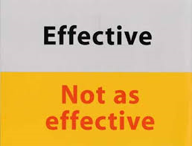
Studies conducted in both methadone programs and psychosocial counseling treatment programs demonstrate that incentive-based interventions are highly effective in increasing treatment retention and promoting abstinence from drugs.

Slide 4
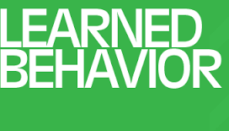
Operant Behavior
Drug use is maintained in part by the pharmacological actions of the drug in conjunction with social and other reinforcement derived from the lifestyle
Considered a normal learned behavior

Slide 5

The goal is to systematically weaken drug use and strengthen drug abstinence
Interventions arrange the environment that reinforce or punish contingent on drug abuse or other behavior deemed therapeutic (ie: counseling attendance)
Usually is a component of a more comprehensive treatment intervention

Slide 6
Voucher-Based Reinforcement (VBR)

Slide 7

The patient receives a voucher for every drug-free urine sample provided.
The voucher has monetary value that can be exchanged for food items, movie passes, or other goods or services that are consistent with a drug-free lifestyle.

Slide 8
Voucher Values Increase with Success!
The voucher values are low at first, but increase as the number of consecutive drug-free urine samples increases; positive urine samples reset the value of the vouchers to the initial low value

Slide 9
VBR has been shown to be effective in promoting abstinence from opioids and cocaine in patients undergoing methadone detoxification.
SEE Psychiatric Times Article-Contingency Management in Addiction Treatment

Slide 10
Prize Incentives CM
(CM=Contingency Management)

Slide 11

This method uses chances to win cash prizes instead of vouchers
Over the course of the program (at least 3 months, one or more times weekly), participants supplying drug-negative urine or breath tests draw from a bowl for the chance to win a prize worth between $1 and $100.

Slide 12
Participants may also receive draws for attending counseling sessions and completing weekly goal-related activities.
The number of draws starts at one and increases with consecutive negative drug tests and/or counseling sessions attended but resets to one with any drug-positive sample or unexcused absence.

Slide 13
Could promote gambling?
However, studies examining this concern found that Prize Incentives CM did not promote gambling behavior

Slide 14
Principles of Drug Addiction Treatment: A Research-Based Guide (Third Edition): Contingency Management Interventions/Motivational Incentives (Alcohol, Stimulants, Opioids, Marijuana, Nicotine)
  http://www.drugabuse.gov/publications/principles-drug-addiction-treatment-research-based-guide-third-edition/evidence-based-approaches-to-drug-addiction-treatment/behavioral-0

Slide 15
CM is not…A substitute for counseling
CM does not teach new skills
CM DOES strengthen behaviors that lead to positive outcomes
Counselors can explore what their clients did to avoid using drugs and build upon that

